Slide 1
GRADIENT DESCENT & OPTIMIZATION

Slide 2
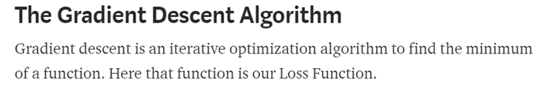
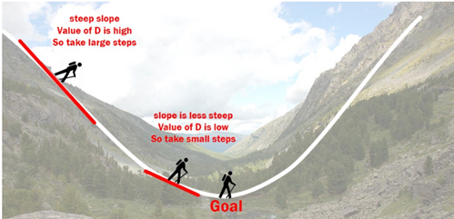
INTRODUCTION TO GRADIENT DESCENT

Slide 3
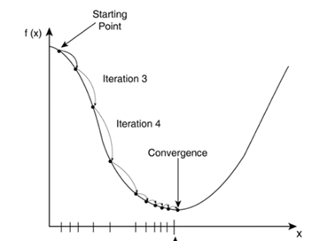
INTRODUCTION TO GRADIENT DESCENT

Slide 4
INTRODUCTION TO GRADIENT DESCENT
But where is the advantage?

Slide 5
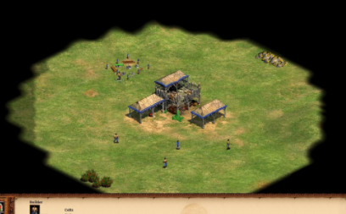
INTRODUCTION TO GRADIENT DESCENT
But where is the advantage?

Slide 6
INTRODUCTION TO GRADIENT DESCENT
But where is the advantage?

Slide 7
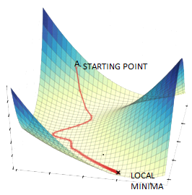
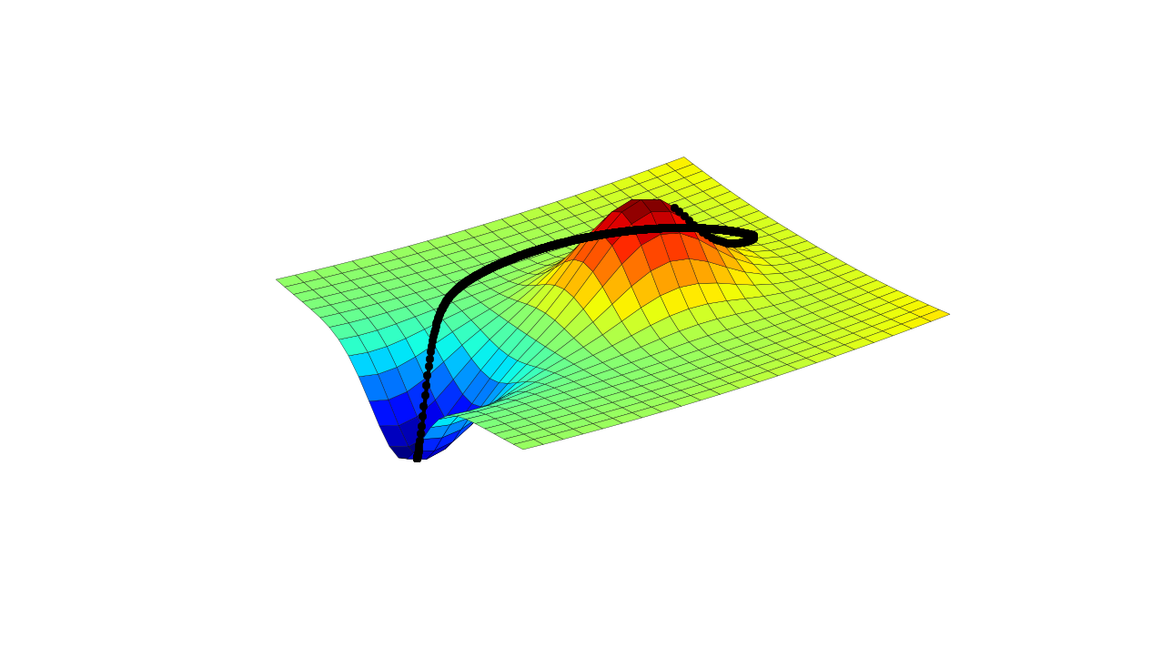
INTRODUCTION TO GRADIENT DESCENT

Slide 8
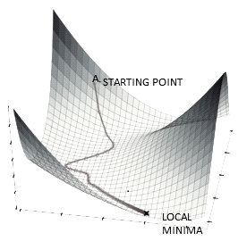

INTRODUCTION TO GRADIENT DESCENT

Slide 9
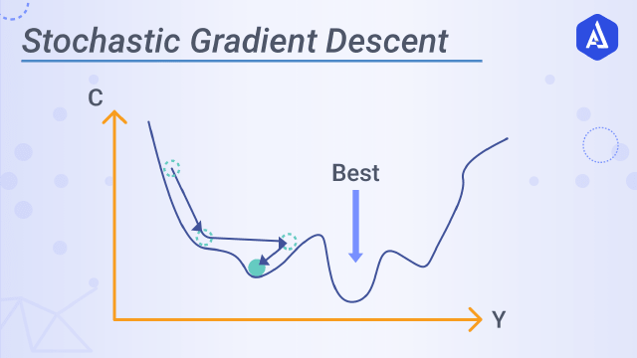
INTRODUCTION TO GRADIENT DESCENT

Slide 10
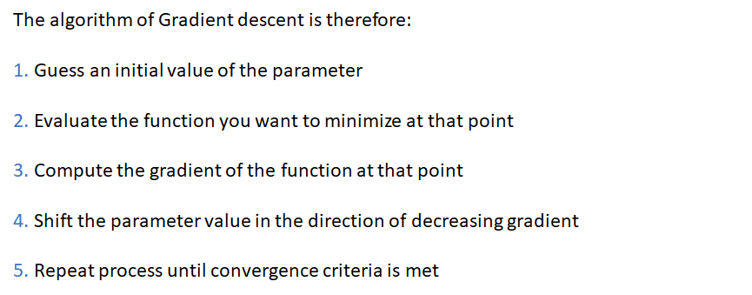
THE ALGORITHM

Slide 11
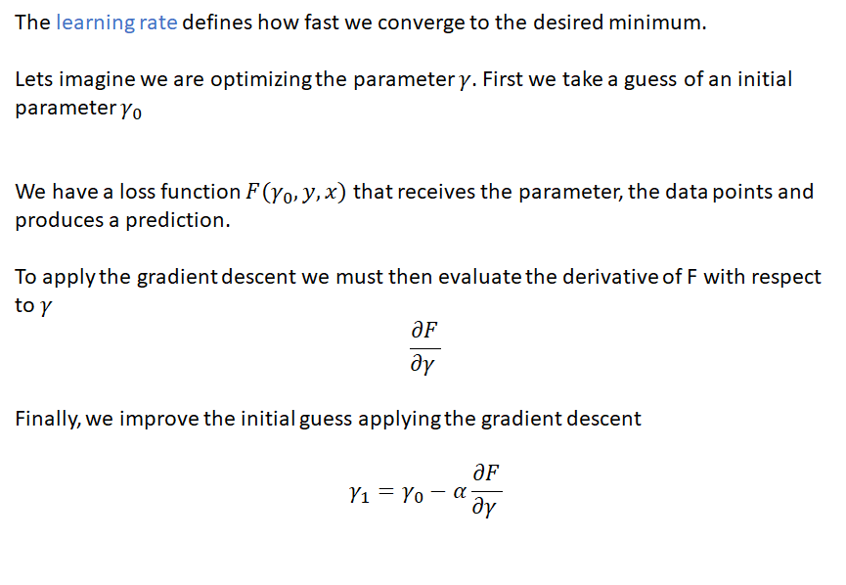
THE ALGORITHM

Slide 12
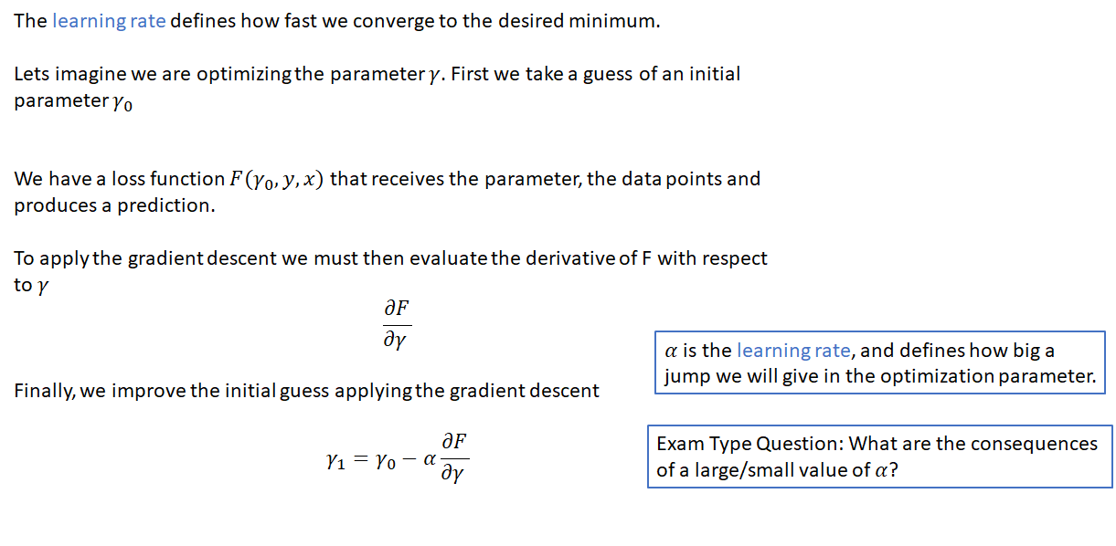
THE ALGORITHM

Slide 13
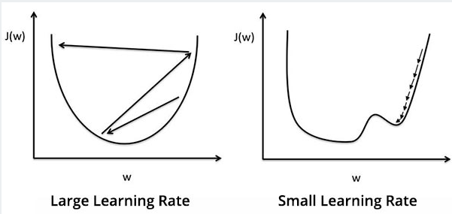
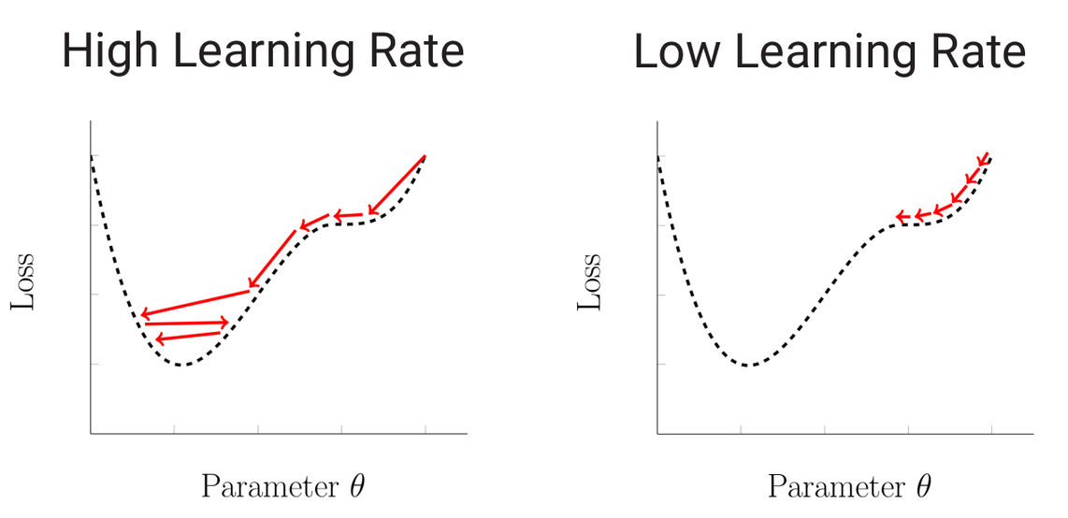
THE ALGORITHM

Slide 14
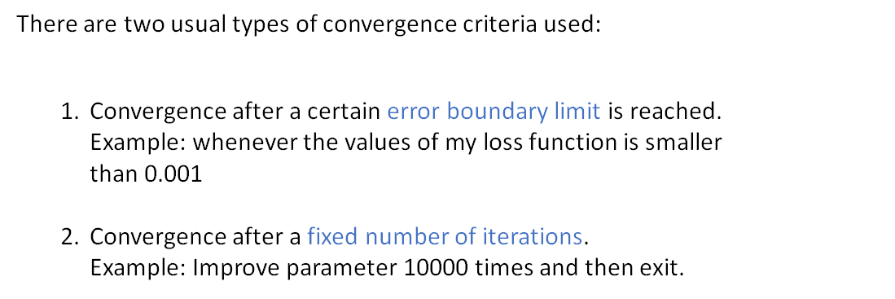
THE ALGORITHM

Slide 15
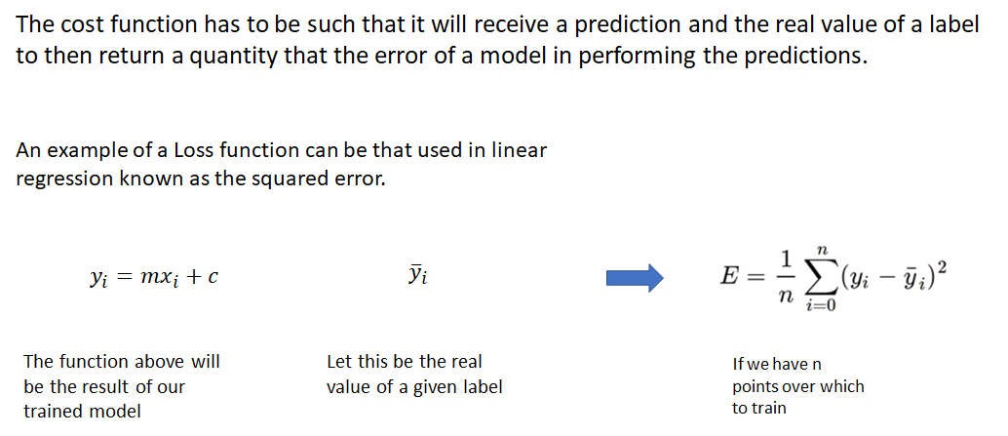
EXAMPLE FOR LINEAR REGRESSION

Slide 16
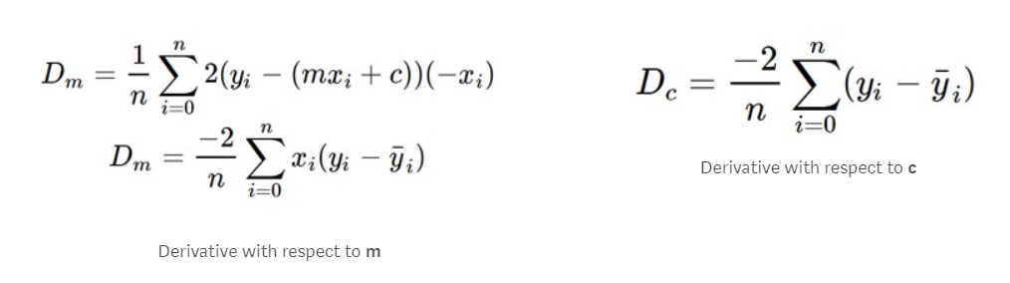
EXAMPLE FOR LINEAR REGRESSION

Slide 17
ANY QUESTIONS ?

